Slide 1
Data Engineering & Administration - SQL
Nidheesh M., PhD
School of Biotechnology

Slide 2
Contents
Overview of The SQL Query Language
History
Data Definition
Data Manipulation
Data Control
Set Operations
Queries & Subqueries

Slide 4
SQL –Structured Query Language
Standardized by AN SI and ISO.
Language to interact with Database.
The standard for relational database management systems (RDBMS)
  Reduced training costs
  Productivity
  Application portability
  Application longevity
  Reduced dependence on a single vendor
  Cross-system communication

Slide 5
History of SQL
1970–E. F. Codd develops relational database concept
1974-1979–System R with Sequel (later SQL) created at IBM Research Lab
1979–Oracle markets first relational DB with SQL
1981 – SQL/DS first available RDBMS system on DOS/VSE
Others followed: INGRES (1981), IDM (1982), DG/SGL (1984), Sybase (1986)
1986–ANSI SQL standard released
1989, 1992, 1999, 2003, 2006, 2008–Major ANSI standard updates
Current–SQL is supported by most major database vendors

Slide 6
SQL Environment
Catalog
  A set of schemas that constitute the description of a database
Schema
  The structure that contains descriptions of objects created by a user (base tables, views, constraints)
Data Definition Language (DDL)
  Commands that define a database, including creating, altering, and dropping tables and establishing constraints
Data Manipulation Language (DML)
  Commands that maintain and query a database
Data Control Language (DCL)
  Commands that control a database, including administering privileges and committing data

Slide 7
SQL –Structured Query Language
Standardized by AN SI and ISO.
Language to interact with Database.
Partitioned into
  Data Definition Language.
  Data Manipulation Language.
  Data Control Language.

Slide 8
Data Definition Language-DDL
Used to define the data.
Example : Creating a DB Object.
Commands:
  CREATE
  ALTER
  DROP

Slide 9
Basic MySQL Data Types
Integer | Real | Text
TINYINT | FLOAT | CHAR (<length>)
SMALLINT | DOUBLE | VARCHAR (<maxlength>)
MEDIUMINT | DOUBLE PRECISION
INT | REAL
INTEGER | DECIMAL
BIGINT | DEC
 | NUMERIC
 | FIXED

Slide 10
SQL Database Definition
Data Definition Language (DDL)
Major CREATE statements:
  CREATE SCHEMA–defines a portion of the database owned by a particular user
  CREATE TABLE–defines a new table and its columns
  CREATE VIEW–defines a logical table from one or more tables or views
Other CREATE statements: CHARACTER SET, COLLATION, TRANSLATION, ASSERTION, DOMAIN

Slide 11
Steps in Table Creation
Identify data types for attributes
Identify columns that can and cannot be null
Identify columns that must be unique (candidate keys)
Identify primary key–foreign key mates
Determine default values
Identify constraints on columns (domain specifications)
Create the table and associated indexes

Slide 12
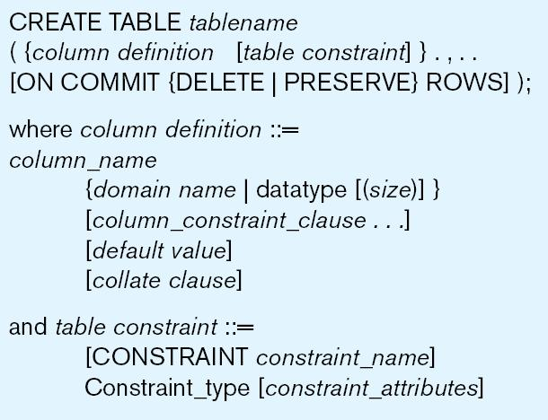
CREATE TABLE COMMAND

Slide 13
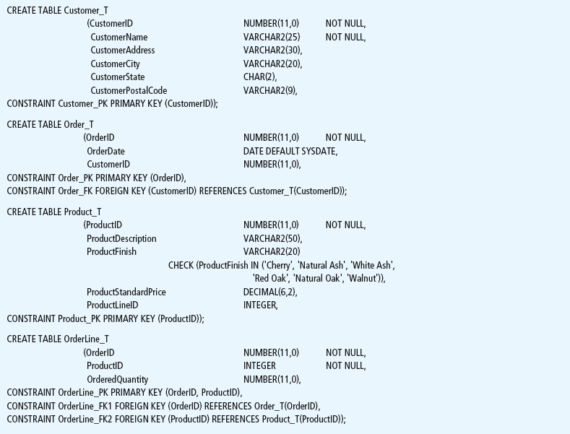
CREATE
TABLE COMMAND

Slide 14

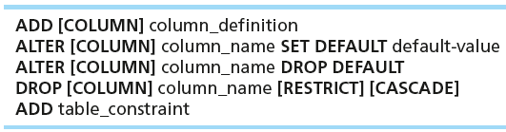

Changing Tables
ALTER TABLE statement allows you to change column specifications:
Table Actions:
Example (adding a new column with a default value):

Slide 15
Removing Tables
DROP TABLE statement allows you to remove tables from your schema:
  DROP TABLE Customers;

Slide 16
Data Manipulation Language
Used to do manipulation on data in DB objects.
Data manipulations are:
  INSERT
  DELETE
  UPDATE
  SELECT (Data Query Language)

Slide 17
DML cntd…
INSERT : Used to insert a new row into a table.
Syntax:
INSERT INTO TableName VALUES (Value1,Value2,…);

Slide 18



Insert Statement
Adds one or more rows to a table
Inserting into a table
Inserting a record that has some null attributes requires identifying the fields that actually get data
Inserting from another table

Slide 19
UPDATE
UPDATE command is used to change the values in table.
Syntax:
UPDATE TableName SET ColumnName=Value WHERE Condition

Slide 20

Update Statement
Modifies data in existing rows

Slide 21
DELETE
DELETE command removes rows from the table.
Syntax:
DELETE FROM TableName WHERE Condition

Slide 22
Delete Statement
Removes rows from a table
Delete certain rows
  DELETE FROM CUSTOMER WHERE CUSTOMERSTATE = ‘HI’;
Delete all rows
  DELETE FROM CUSTOMER;

Slide 23
SELECT
SELECT command is used to retrieve records from the DB objects.
Syntax:
SELECT * FROM TableName

Slide 24
SELECT cntd.. (PROJECTION)
Here we retrieve content of selected
attributes (Columns).
Example
SELECT PlantId, Name FROM DiaPlants;

Slide 25
SELECT cntd.. (RESTRICTION)
Restriction/Filtration is done on rows for which one or multiple condition could be specified.
Example
SELECT * FROM DiaPlants WHERE Genus = ‘Achyrocline’;

Slide 26
SELECT cntd... (RESTRICTION)
In order to give multiple condition, we may use following logical operators
AND
OR
NOT

Slide 27
SELECT cntd.. (RESTRICTION)
Example
SELECT * FROM DiaPlants WHERE NOT(Genus = ‘Achyrocline’ OR Genus = ‘Aframomum’);

Slide 28
SELECT cntd… (Other operators)
SET Operators
    UNION
    INTERSECTION
    MINUS

Slide 29
SET Operators
B
A
UNION :A U B

Slide 30
SET Operators cntd…
A
B
INTERSECION A ∩B

Slide 31
SET operators cntd…
A
B
MINUS : A - B

Slide 32
SET Operator - UNION
UNION includes rows from both the queries
SELECT * FROM DiaPlants
UNION
SELECT * FROM canPlants;

Slide 33
SET Operator - INTERSECT
INTERSECTION includes rows which are common for both the queries
SELECT * FROM DiaPlants
INTERSECT
SELECT * FROM canPlants;

Slide 34
SET Operator - MINUS
MINUS removes rows which are common for both the queries and retrieves remaining rows from first query
SELECT * FROM DiaPlants
MINUS
SELECT * FROM CanPlants;

Slide 35
SELECT - Joins
Join is the operation by which data from multiple tables are joined.
A join is a query that combines rows from two or more tables
Example
SELECT E.EmpNo,E.EName,D.DName FROM Emp E, Dept D WHERE E.DeptNo = D.DeptNo;

Slide 36
Types of Join
Equi Join
An equijoin is a join with a join condition containing an equality operator.
Self Join
A self join is a join of a table to itself.
Outer Join
The outer join extends the result of a simple join. An outer join returns all rows that satisfy the join condition and those rows from one table for which no rows from the other satisfy the join condition.

Slide 37
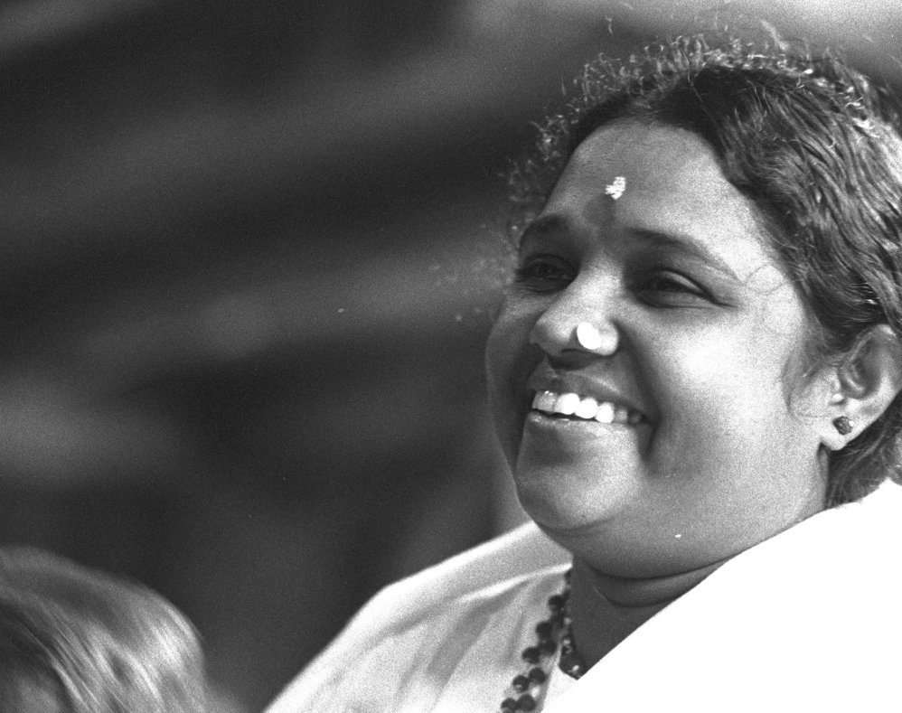
Thank You
“Be like the honeybee who gathers only nectar wherever it goes. Seek the goodness that is found in everyone.”
-- Mata Amritanandamayi

